Slide 1
CS-1204
Object-Oriented Programming
(3+1)
Week 09
By
Engr. Muhammad Awais
Prepared by : Engr. M.Awais

Slide 2
Contents
Polymorphism in C++
Function Overloading
Overriding
Virtual Functions
Prepared by : Engr. M.Awais
Notes:
M.Awais

Slide 3
Learning Objectives
Understand the concept of polymorphism
Differentiate between compile-time and run-time polymorphism
Understand function overloading and overriding
Learn the role of virtual functions
Implement examples and perform hands-on lab tasks
Prepared by : Engr. M.Awais
Notes:
M.Awais

Slide 4
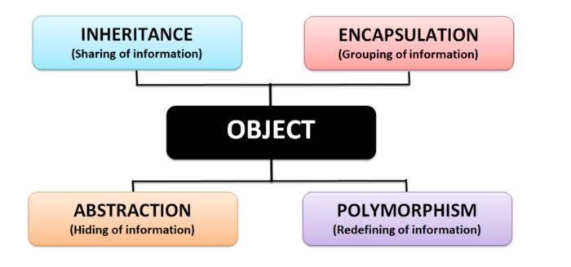
Pillars of OOP
Prepared by : Engr. M.Awais
Notes:
M.Awais

Slide 5
What is Polymorphism?
Polymorphism means "many forms"
Same function name behaves differently in different contexts
Two types in C++:
  Compile-time polymorphism (Static Binding)
  Run-time polymorphism (Dynamic Binding)
Prepared by : Engr. M.Awais
Notes:
M.Awais

Slide 6
Compile-Time Polymorphism?
Achieved using
  Function Overloading
  Operator Overloading
Resolved at compile time – static binding
Example: Calculator with multiple add() functions
Prepared by : Engr. M.Awais
Notes:
M.Awais

Slide 7
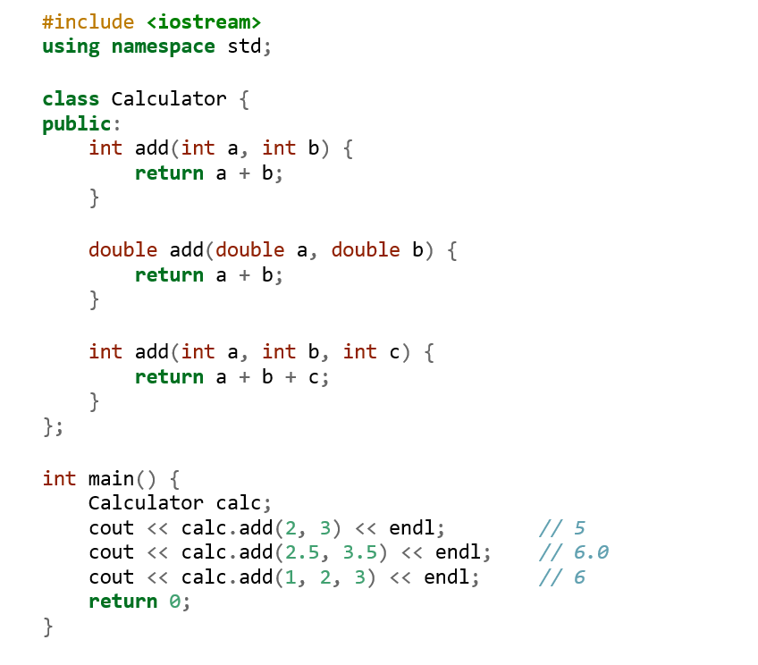
Example : Compile-Time Polymorphism
Prepared by : Engr. M.Awais
Notes:
M.Awais

Slide 8
Run-Time Polymorphism?
Achieved using
  Function Overriding and Virtual Functions
Resolved at run time
Based on object type (dynamic binding)
Prepared by : Engr. M.Awais
Notes:
M.Awais

Slide 9
Function Overriding?
Same function name and signature in base and derived class
Involves inheritance
Used to provide specific implementation in derived class.
Prepared by : Engr. M.Awais
Notes:
M.Awais

Slide 10
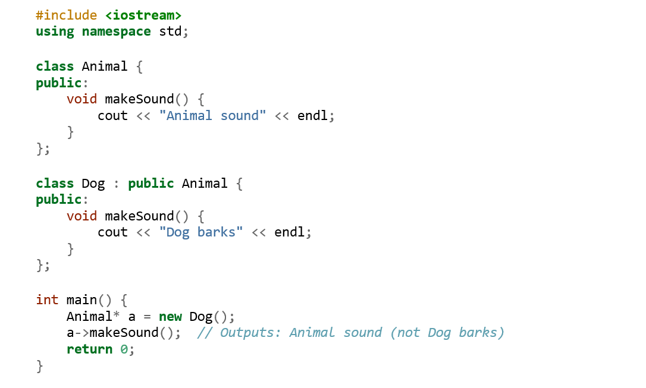
Function Overriding Example Without Virtual Functions
Prepared by : Engr. M.Awais
Notes:
M.Awais

Slide 11
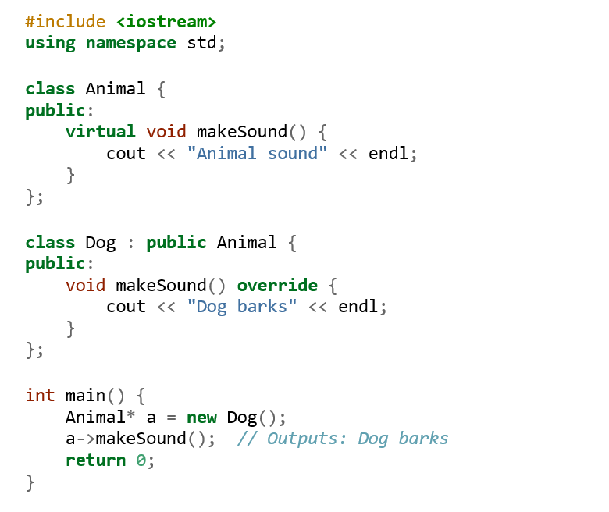
Function Overriding Example With Virtual Functions
Prepared by : Engr. M.Awais
Notes:
M.Awais

Slide 12
Practice Example
  Shape Area
  Create base class Shape with virtual double area()
  Derive Rectangle and Circle
  Override area() to compute actual values
  Use Shape* pointer to access different shapes.
Prepared by : Engr. M.Awais

Slide 13
References
  https://www.geeksforgeeks.org/cpp/cpp-polymorphism/
  https://www.w3schools.com/cpp/cpp_polymorphism.asp
Prepared by : Engr. M.Awais

